Slide 1
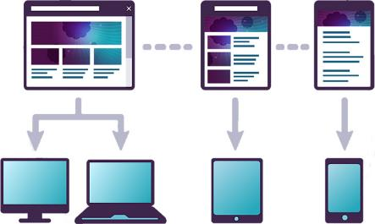


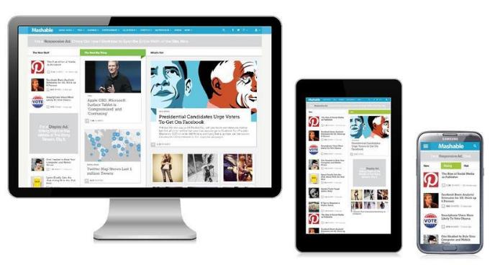
Responsive Design
The optimal web awesomeness
Telerik Software Academy
Learning & Development Team
http://academy.telerik.com

Slide 2

Table of Contents
Responsive Design
Creating Responsive Design
Fluid Layout
Flexible Images and types
Media Queries
Media Queries Everywhere
Constructing Responsive Design

Slide 3
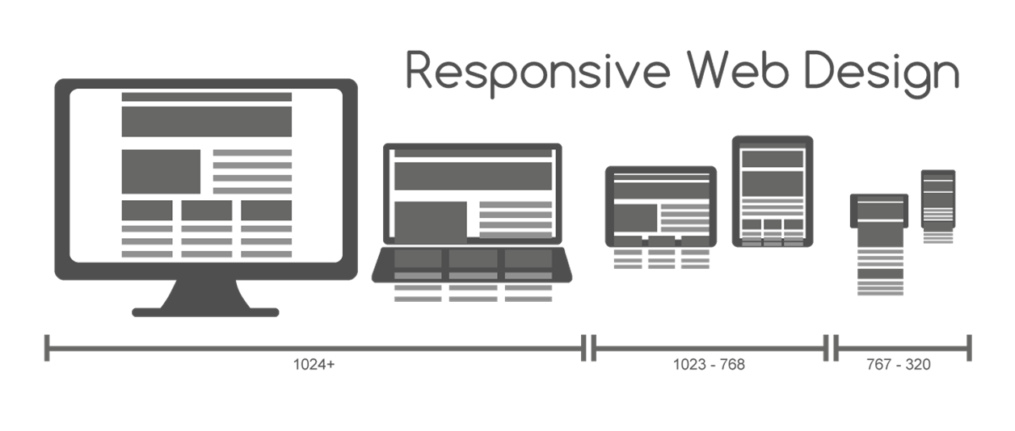
Responsive Design

Slide 4
Responsive Design
Responsive design is an approach to optimize the viewing experience on range of devices
Better user experience on mobile, desktop, TV
The UI depends on the device and device specifics
Resolution, DPI, color range, etc…

Slide 5
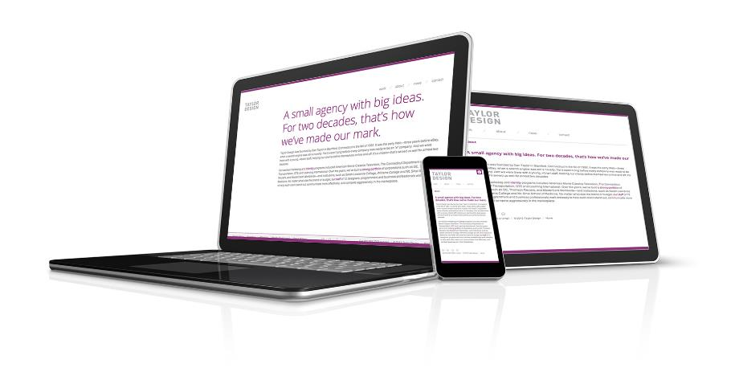
Responsive Design
Live Demo

Slide 6
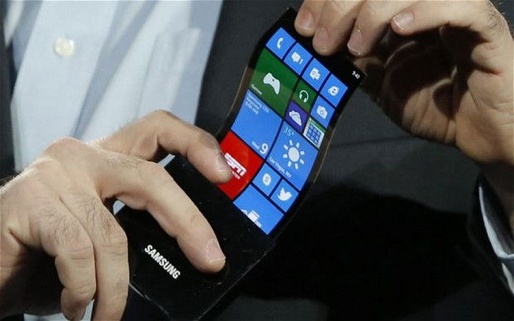
Creating Responsive Design
Ways to implement nice UI

Slide 7
Creating Responsive Design
Responsive design can be accomplished by using one or more of the following:
Fluid layout
Use proportional values for width, margin, etc…
Flexible types
All type sizes are based on the root
Flexible images
Images cannot go beyond their container
Media queries
Apply styles based on the client

Slide 8


Fluid Layout
Make elements flow on the screen

Slide 9
Fluid Layout
Fluid layout uses proportional sizes
Pros:
UI responds better to the client resolution
Spares code on media queries
Cons:
More whitespace on large screens (TV)
Sub nav
content
aside
12%
60%
20%
Margins:2%

Slide 10

Fluid Layout
Live Demo

Slide 11
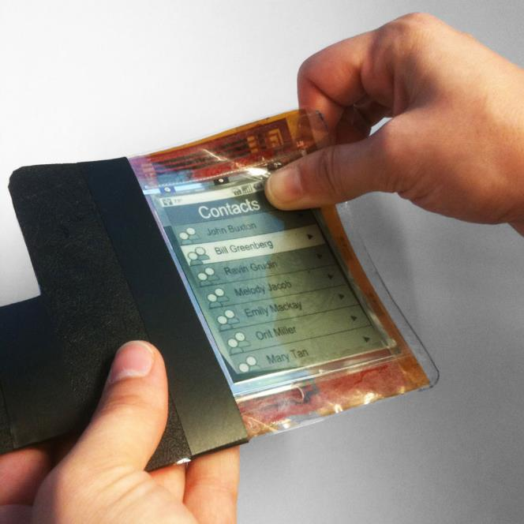
Flexible Images

Slide 12
Flexible Images
Using fluid design is just nice
But fluid design is broken when it comes to using elements with fixed size
By concept images are always with fixed size

Slide 13
Flexible Images - Example
Example:
Resolution: 1024px, container with width: 60% ( = 60% * 1024 = 614.4px) and an image with width: 500px
Seems OK
When the resolution becomes 780px, the container's width is still 60% (now 468px), and the images width is still 500px
The image overflows its container

Slide 14
Making Images Flexible
The fix to the image overflow is simple
Just a reset in the top of the CSS
max-width overrides the width property
If the image size is larger than the container's size, the image gets all the width
img { max-width:100%}

Slide 15
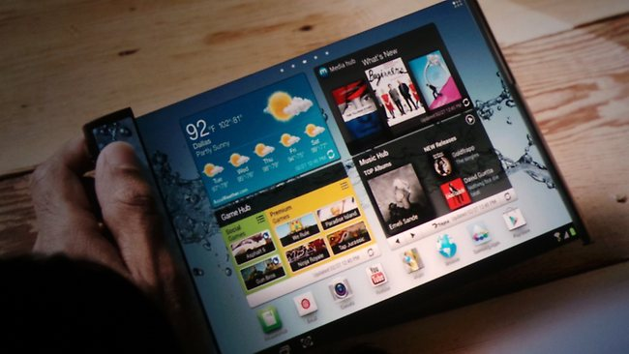
Flexible Images
Live Demo

Slide 16
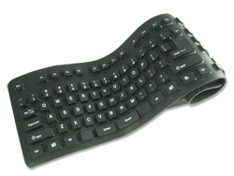
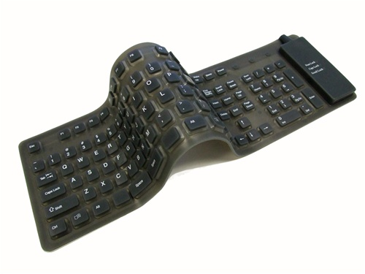
Flexible Type

Slide 17
Flexible Type
Flexible type means proportional font size based on the context (parent)
Instead of pixels use proportional values (em)
Make all the font sizes based on the context
To change the font-size of all elements just change the context's font-size

Slide 18
Flexible Type (2)
Making fonts "responsive" needs a little math
ems = targetPx / rootPx
1.4375em = 23px / 16px
body{ font-size:16px}
body header{ font-size:23px} // 23 / 16 = 1.4375
body{ font-size:16px;}
body header{ font-size:1.4375em}

Slide 19

Flexible Type
Live Demo

Slide 20
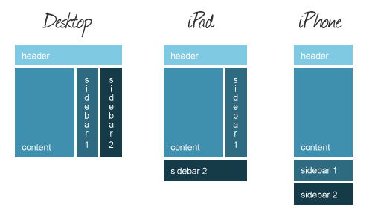
Media Queries

Slide 21
Media Queries
Media queries are part of CSS 3
Supported in all major browsers
A media query consists of a media type and at least one expression
By using media features like width, height and color
MQs change the presentation of content
Not the content itself

Slide 22
Media Queries (2)
Media queries consist of a media type and expressions evaluated to TRUE or FALSE
If the evaluated result is TRUE, the styles in the query are applied
.box {width: 250px; height: 250px; display: inline-block}
@media only screen and (max-width: 1024px) {
.box {width: 300px; height: 300px}
}
@media only screen and (max-width: 960px) {
.box {width: 310px; height: 310px}
}
@media only screen and (max-width: 480px) {
.box { display: block; width: 95%; height:auto}
}

Slide 23
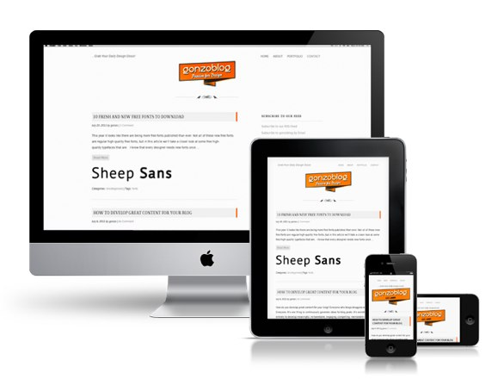
Media Queries
Live Demo

Slide 24
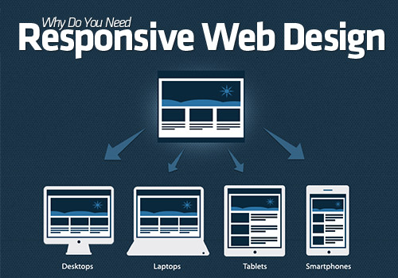
Media Queries Everywhere
Leverage the MQ support on most browsers

Slide 25
Polyfills
Polyfills are scripts that leverage support for some functionality
HTML 5 tags, CSS 3 properties, JS APIs, etc…
Polyfills are just a bunch of JavaScript that fills a specific hole in functionality
Media queries
Gradients
JavaScript canvas

Slide 26
Media Queries Everywhere
Media queries are part of CSS 3
i.e. their support is limited to newer browsers
Media queries can be made to work in all browsers using a polyfill
Many MQ polyfills exists and their usage is similar
Just include the polyfill js file into the HTML
You have media queries on IE7

Slide 27
Media Queries Everywhere
Live Demo

Slide 28
Constructing Responsive Design
All of the above in one place

Slide 29
Constructing a Responsive Design
The construction of responsive design combines all of the above
Fluid layout
Flexible images
Media queries
Actually this all can be done only with media queries
The code becomes too much and very hard to maintain

Slide 30
Responsive Design and Media Queries

